Slide 1
IAS 7 Statement of cash flows (Part I)
Full set of
financial statements:
Statement of
financial position
Accrual principle
Statement of comprehensive income
Statement of
changes in equity
Statement of
cash flows
Cash basis
Notes to the
financial statements
Extra information

Slide 2
IAS 7 Statement of cash flows
Discussion
What do you think is more important: net profit for the year or cash?
Why…?
Slide 2

Slide 3
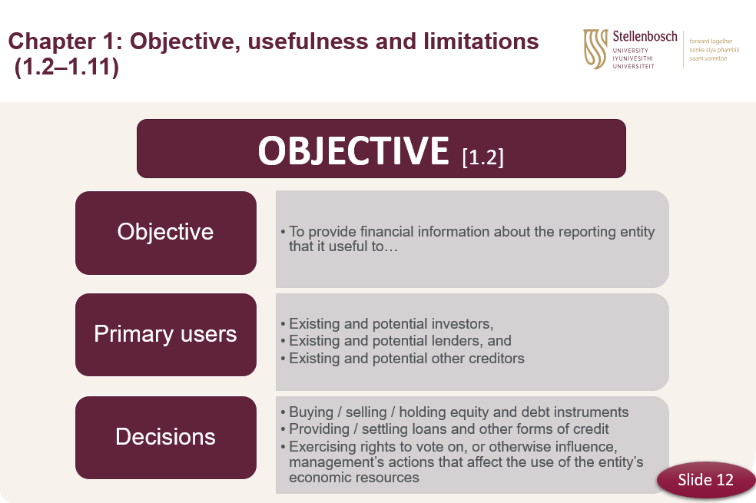
IAS 7 Statement of cash flows
Slide 3

Slide 4
IAS 7 Statement of cash flows Objective
Provides useful information to users w.r.t. company’s:
ability to generate cash; and
needs to utilise that cash.
Standard therefore provides guidelines on how company should present the info regarding changes in cash and cash equivalents w.r.t.:
Operating activities;
Investing activities;
Financing activities; and
Net changes in cash and cash equivalents (beginning to end)
Slide 4

Slide 5
IAS 7 Statement of cash flows Scope (.1 - .3)
All companies
As integral part of its financial statements for each period for which financial statements are presented
IAS 7 requires comparatives, but for FA 178 only disclose one year
Slide 5

Slide 6
IAS 7 Statement of cash flows Definitions (.6)
Cash refers to cash on hand and demand deposits.
Cash equivalents are short-term, highly liquid investments that are readily convertible to known amounts of cash and which are subject to an insignificant risk of changes in value.
Cash flows are inflows and outflows of cash and cash equivalents.
Operating activities are the principal revenue-producing activities of the entity and other activities that are not investing or financing activities.
Investing activities are the acquisition and disposal of long-term assets and other investments not included in cash equivalents.
Financing activities are activities that result in changes in the size and composition of the contributed equity and borrowings of the entity.
IAS7 par.6 and theory pack
Slide 6

Slide 7
Stellenbosch Ltd. Statement of financial position on 31 December 2022
 |  | 2022
Assets | Note | R
Non-current assets
Property, plant and equipment | 2
Intangible assets | 3
Investment property | 4
Investments in subsidiaries | 5
Loan to subsidiary | 6
Financial assets at fair value through profit or loss | 7
Current assets
Inventories | 8
Trade and other receivables | 9
Cash and cash equivalents | 10
Total assets
Equity and liabilities
Share capital | 11
Retained earnings
Other components of equity | 12
Total equity
Non-current liabilities
Borrowings | 13
Debentures | 14
Provisions | 15
Current liabilities
Trade and other payables | 16
Borrowings | 13
Income tax payable
Dividends payable
Total liabilities
Total equity and liabilities
STATEMENT OF CASH FLOWS FOR THE YEAR ENDED………………
 | Note | R
Cash in/(out)flow from operating activities |  | xxxxx
Cash receipts from customers
Cash paid to employees and suppliers |  | ( )
Cash generated from operations | 2
Tax paid |  | ( )
Tax received
Cash in/(out)flow from investing activities |  | xxxxx
Acquisition of property, plant and equipment |  | ( )
Replacement of ……………. (maintain) |  | ( )
Expansion of ……………….. (expand) |  | ( )
Proceeds on the sale of property, plant and equipment
Acquisition of investments |  | ( )
Proceeds on the sale of investments
Interest received (IFRS 18) Dividends received (IFRS 18)
Cash in/(out)flow from financing activities |  | xxxxx
Proceeds from the issue of share capital
Proceeds from the long-term loans incurred
Long-term loans paid back |  | ( )
Redemption of debentures |  | ( )
Interest paid (IFRS 18) |  | ( )
Dividends paid (IFRS 18) |  | ( )
Net increase / (decrease) in cash and cash equivalents |  | xxxxx
Cash and cash equivalents at beginning of year |  | xxxxx
Cash and cash equivalents at end of year |  | xxxxx

Slide 8
IAS 7 Statement of cash flows Cash and cash equivalents (.7 – .9)
Cash equivalents normally held for short term cash commitments rather than for investment purposes (.7)
Bank borrowings are generally considered to be financing activities unless overdraft is repayable on demand (part of cash management; included as component of cash and cash equivalents) (.8)
Movements between cash and cash equivalents are excluded from cash flows because these components are part of the cash management of an entity rather than part of its operating, investing and financing activities (.9)
Slide 8

Slide 9
IAS 7 Statement of cash flows Presentation of a statement of cash flows (.10 – .12)
Classified by (.10):
Operating activities;
Investing activities;
Financing activities; and
Net movement in cash and cash equivalents (total of above)
Sometimes a single transaction is more than one type of activity
[e.g. repayment of loan = interest (operating) and capital (financing)] (.12)
Slide 9

Slide 10
IAS 7 Statement of cash flows Operating activities (.13 – .15)
Indicator of extent to which entity’s operations were successful in generating cash to (.13)
Repay loans
Maintain operating capability of entity
Make new investments without recourse to external sources of financing
Dividends and interest ONLY IF your primary business model/ income-producing activity involves collecting dividends and interest (i.e. Banks).
Primarily derived from principal revenue-producing activities (.14)
What if hold securities and loans for dealing or trading purposes? (.15)
Slide 10

Slide 11
Stellenbosch Ltd. Statement of financial position on 31 December 2022
 |  | 2022
Assets | Note | R
Non-current assets
Property, plant and equipment | 2
Intangible assets | 3
Investment property | 4
Investments in subsidiaries | 5
Loan to subsidiary | 6
Financial assets at fair value through profit or loss | 7
Current assets
Inventories | 8
Trade and other receivables | 9
Cash and cash equivalents | 10
Total assets
Equity and liabilities
Share capital | 11
Retained earnings
Other components of equity | 12
Total equity
Non-current liabilities
Borrowings | 13
Debentures | 14
Provisions | 15
Current liabilities
Trade and other payables | 16
Borrowings | 13
Income tax payable*
Dividends payable
Total liabilities
Total equity and liabilities
Operating activities
+ certain items in SCI
(main business to generate income)
*If a part of the tax can be directly attributed to an asset or a financing activity, then the tax needs to be classified as an investing or financing activity as appropriate

Slide 12
IAS 7 Statement of cash flows Investing activities (.16)
Indicator of extent to which expenditures have been made for resources intended to generate future income and cash flows.
Payments to acquire / proceeds from disposal of:
PPE, intangibles and other long-term assets
Equity or debt instruments in other entities
Loans receivable and advances, etc.
Ignore .16(g) and (h) for FA178
In other words, only if an ASSET was recognised in SFP
Cash receipts of interest and dividends (IFRS 18)
Slide 12

Slide 13
Stellenbosch Ltd. Statement of financial position on 31 December 2022
 |  | 2022
Assets | Note | R
Non-current assets
Property, plant and equipment | 2
Intangible assets | 3
Investment property | 4
Investments in subsidiaries | 5
Loan to subsidiary | 6
Financial assets at fair value through profit or loss | 7
Current assets
Inventories | 8
Trade and other receivables | 9
Cash and cash equivalents | 10
Total assets
Equity and liabilities
Share capital | 11
Retained earnings
Other components of equity | 12
Total equity
Non-current liabilities
Borrowings | 13
Debentures | 14
Provisions | 15
Current liabilities
Trade and other payables | 16
Borrowings | 13
Income tax payable*
Dividends payable
Total liabilities
Total equity and liabilities
Investing activities
+ certain items in SCI
(main business to generate income)
+ certain items in SCI
(ex. Profit / loss with sale of assets)

Slide 14
IAS 7 Statement of cash flows Financing activities (.17)
Useful in predicting claims on future cash flows by providers of capital to the entity
Proceeds from issuing shares, debentures etc.
Payments to acquire or redeem own shares
Repayments of amounts borrowed, etc.
Cash payments of dividends (IFRS 18)
Cash payments of interest (IFRS 18)
Ignore .17(e) for FA178
Slide 14

Slide 15
Stellenbosch Ltd. Statement of financial position on 31 December 2022
 |  | 2022
Assets | Note | R
Non-current assets
Property, plant and equipment | 2
Intangible assets | 3
Investment property | 4
Investments in subsidiaries | 5
Loan to subsidiary | 6
Financial assets at fair value through profit or loss | 7
Current assets
Inventories | 8
Trade and other receivables | 9
Cash and cash equivalents | 10
Total assets
Equity and liabilities
Share capital | 11
Retained earnings
Other components of equity | 12
Total equity
Non-current liabilities
Borrowings | 13
Debentures | 14
Provisions | 15
Current liabilities
Trade and other payables | 16
Borrowings | 13
Income tax payable*
Dividends payable
Total liabilities
Total equity and liabilities
Financing activities
+ certain items in SCI
(main business to generate income)
+ certain items in SCI
(e.g. Profit / loss with sale of assets)
+ certain items in SCI
(e.g interest)

Slide 16
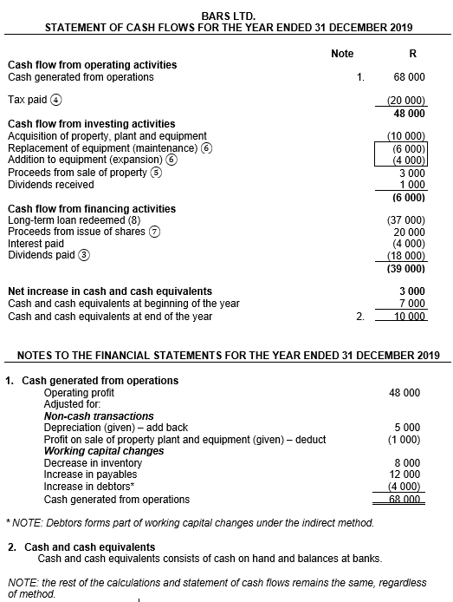
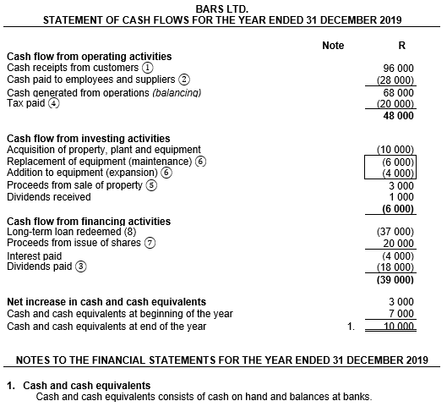
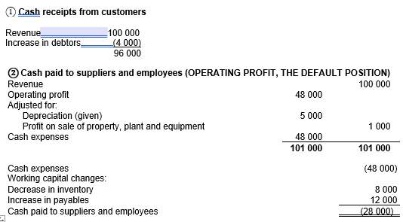
Spot the difference
Slide 16

Slide 17
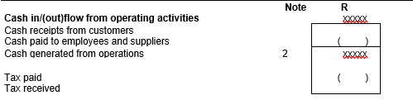
IAS 7 Statement of cash flows Reporting cash flows from operating activities (.18 – .20)
School: indirect method
Direct method (recommended) (.18(a))
Disclose major classes of gross cash receipts and
gross cash payments
Obtain info (.19):
From accounting records or
by adjusting sales, cost of sales and other SCI items for:
Changes during the period in inventories, operating receivables and payables
Other non-cash items
Other items for which the cash effects are investing or financing cash flows
Slide 17

Slide 18
IAS 7 Statement of cash flows Reporting cash flows from operating activities (.18 – .20)
Indirect method (.18(b)) (only take note of existence)
Determine net cash flow from operating activities by adjusting profit/loss for the effects of (.20):
Changes during the period in inventories, operating receivables and payables
Non-cash items
Any deferrals or accruals of past or future operating cash receipts or payments
Other items for which the cash effects are investing or financing cash flows
See question 2
Slide 18

Slide 19
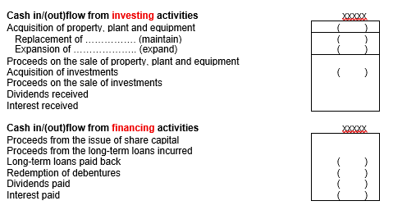
IAS 7 Statement of cash flows Reporting cash flows from investing and financing activities (.21)
Disclose major categories of gross cash receipts and payments arising from investing and financing activities separately (except to the extent that cash flows described in par.22 – .24 are allowed to be reported on a net basis)
Slide 19

Slide 20
IAS 7 Statement of cash flows Reporting cash flows on a net basis (.22 – .24)
Payments and receipts on behalf of customers (.22(a))
Receipts and payments for items in which the turnover is quick, amounts are large and maturities are short (.22(b))
Financial institutions (.24)
Slide 20

Slide 21
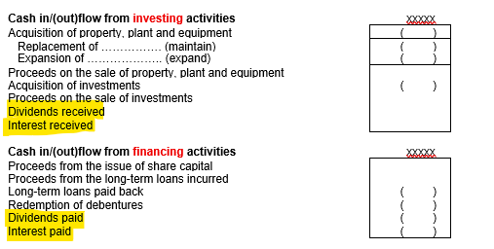
IAS 7 Statement of cash flows Interest and dividends (.31 – .34)
Disclose amounts received and paid separately (.31)
Consistent from period to period (.31)
Classify dividends and interest paid as a financing activity (33A – 34D)
Classify dividends and interest received as investing activities, except for financial institutions (33A – 34D)
Total amount of interest paid should be included in SCF whether it has been recognised as an expense in P/L or capitalised in accordance with IAS 23 (.32)
Slide 21

Slide 22
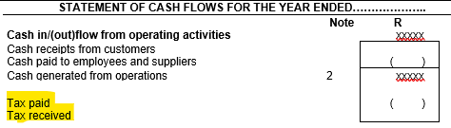
IAS 7 Statement of cash flows Taxes on income (.35 – .36)
Classified as operating activities unless can be specifically identified with financing and investing activities (and practicable) (.35)
If tax cash flows are allocated to more than one class of activity, disclose total tax paid [per class, in that class] (.36)
Slide 22

Slide 23
IAS 7 Statement of cash flows Leave out for FA178
Par.25 – .30 Foreign currency cash flows [Hons.]
Par.37 - .38 Investments in subsidiaries, associates and joint ventures [FA379 and Hons.]
Par.39 - .42B Changes in ownership interests in subsidiaries and other businesses [FA379]
Par.44A - .44E Changes in liabilities arising from financing activities [FA379]
Par.48 - .49 Other disclosure [FA379]
Par.50 – .52 Additional useful disclosure [Hons.]
Par.53 - .61

